Slide 1
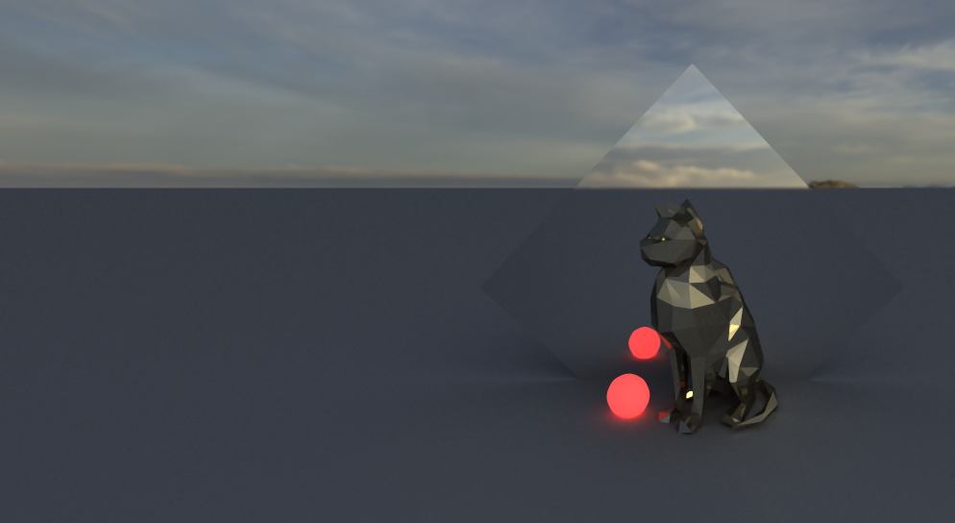

PATH TRACING
PROGRESSIVE RENDERING AND BLUE NOISE

Slide 2




PHONG MODEL
$$\vec{n}$$
$$\vec{v}$$
$$\vec{r}$$
$$L_{o}= L_{e}+ \int{\left(D_{i}+S_{i}\right).L_{i}.\left(ω_{i} \text{∙} n\right)dω_{i}}$$

Slide 3

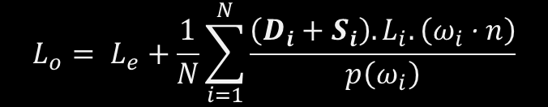

$$L_{o}= L_{e}+ \int{\left(D_{i}+S_{i}\right).L_{i}.\left(ω_{i} \text{∙} n\right)dω_{i}}$$
$$L_{o}= L_{e}+\frac{1}{N}\sum_{i=1}^{N}{\frac{\left(D_{i}+S_{i}\right).L_{i}.\left(ω_{i} \text{∙} n\right)}{p\left(ω_{i}\right)}}$$

Slide 4
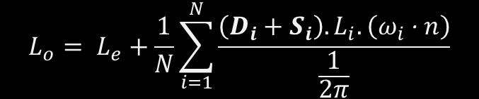

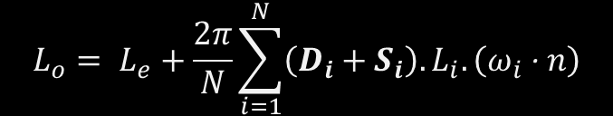
$$L_{o}= L_{e}+\frac{2π}{N}\sum_{i=1}^{N}{\left(D_{i}+S_{i}\right).L_{i}.\left(ω_{i} \text{∙} n\right)}$$
$$L_{o}= L_{e}+\frac{1}{N}\sum_{i=1}^{N}{\frac{\left(D_{i}+S_{i}\right).L_{i}.\left(ω_{i} \text{∙} n\right)}{p\left(ω_{i}\right)}}$$
$$L_{o}= L_{e}+\frac{1}{N}\sum_{i=1}^{N}{\frac{\left(D_{i}+S_{i}\right).L_{i}.\left(ω_{i} \text{∙} n\right)}{\frac{1}{2π}}}$$

Slide 5
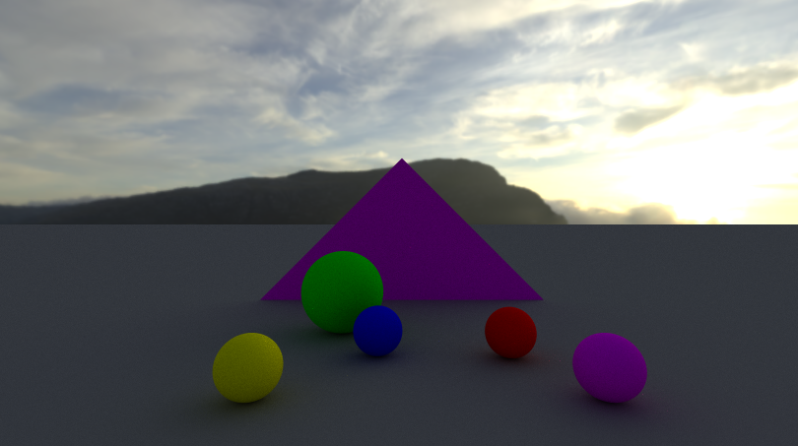
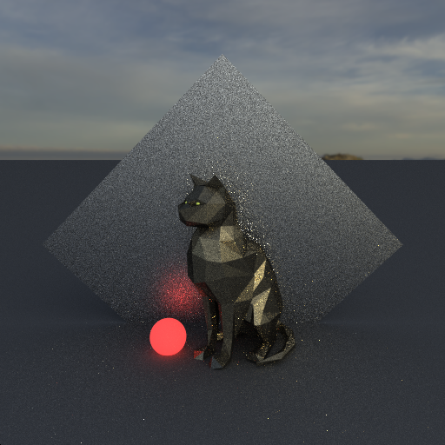
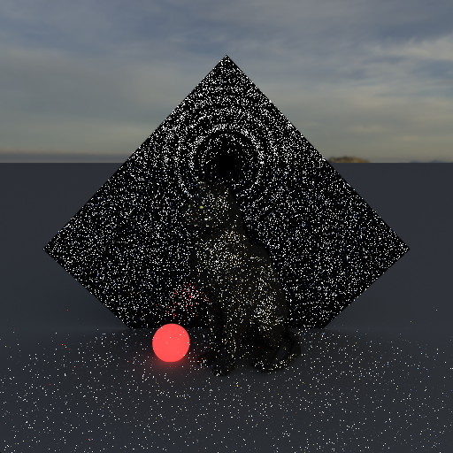
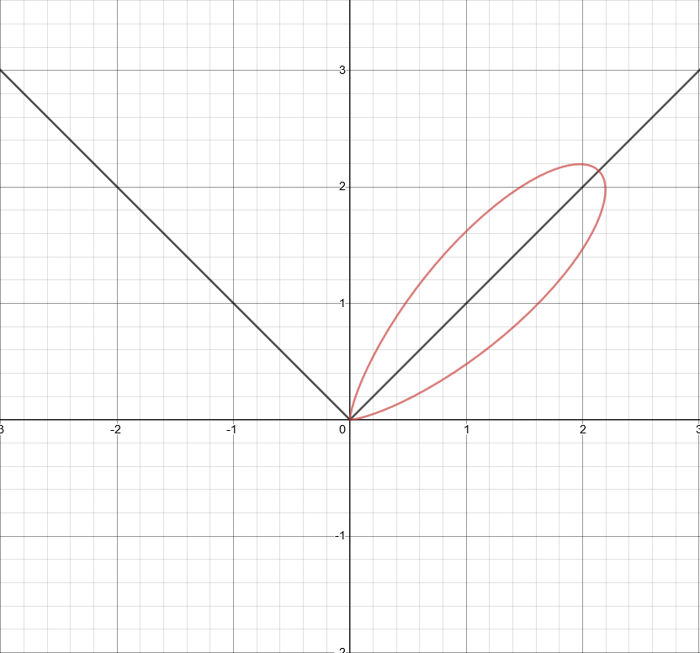
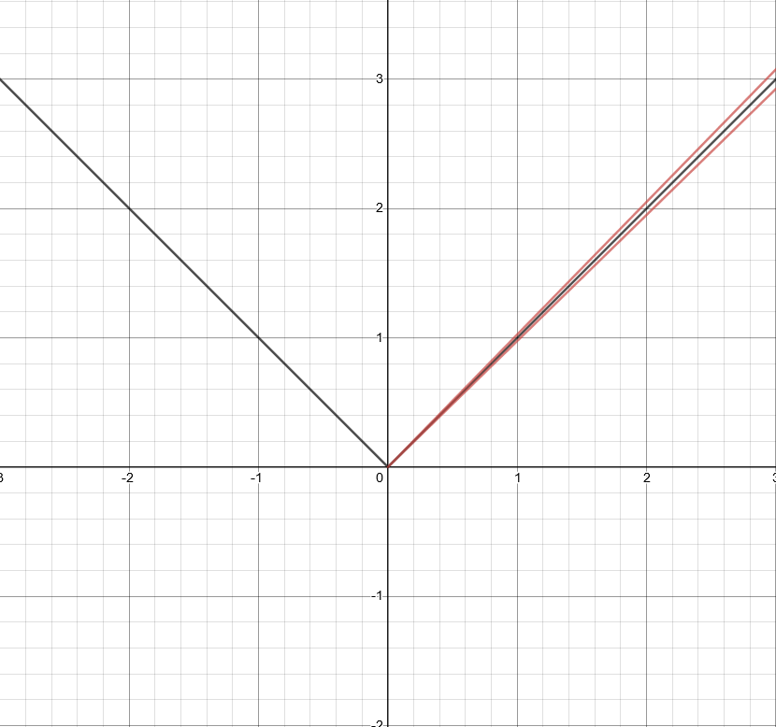

$$L_{o}= L_{e}+\frac{2π}{N}\sum_{i=1}^{N}{\left(D_{i}+S_{i}\right).L_{i}.\left(ω_{i} \text{∙} n\right)}$$

Slide 6
IMPORTANCE SAMPLING

Slide 7

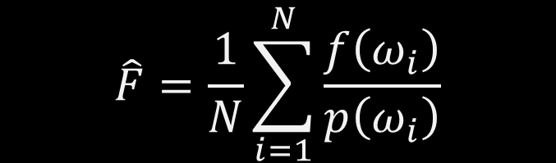
IMPORTANCE SAMPLING
$$\hat{F}=\frac{1}{N}\sum_{i=1}^{N}{\frac{f\left(ω_{i}\right)}{p\left(ω_{i}\right)}}$$
Reduce the disparities
$$p≈f$$

Slide 8
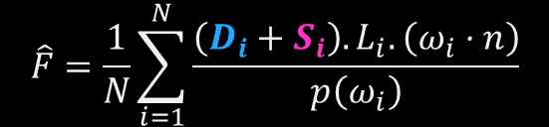
IMPORTANCE SAMPLING
$$\hat{F}=\frac{1}{N}\sum_{i=1}^{N}{\frac{\left(D_{i}+S_{i}\right).L_{i}.\left(ω_{i} \text{∙} n\right)}{p\left(ω_{i}\right)}}$$
Analytical
Cosine Sampling

Slide 9

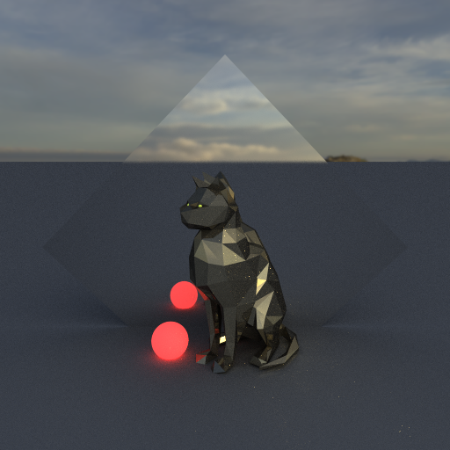


IMPORTANCE SAMPLING
PHONG MODEL
No IS, $\sim$ 6000spp
IS, $\sim$ 300spp

Slide 10
BLUE NOISE

Slide 11
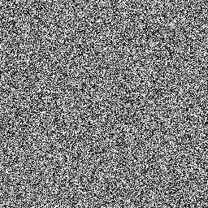
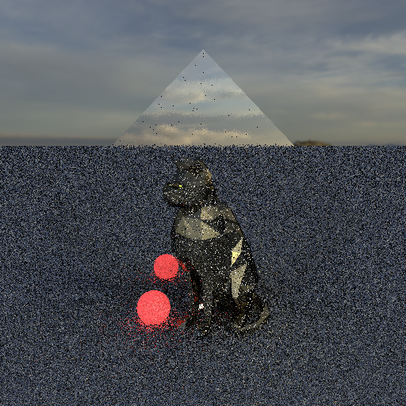

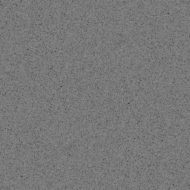
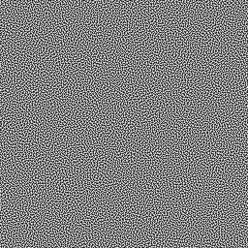
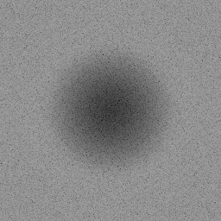
WHITE NOISE
BLUE NOISE

Slide 13

Implementation

Slide 14
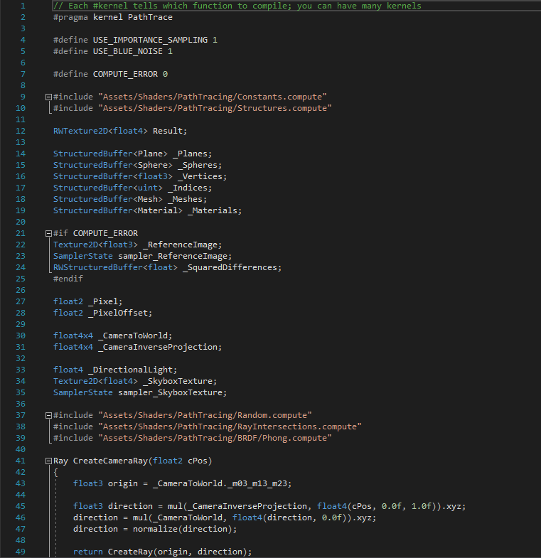
Compute Shader
GPGPU

Slide 15
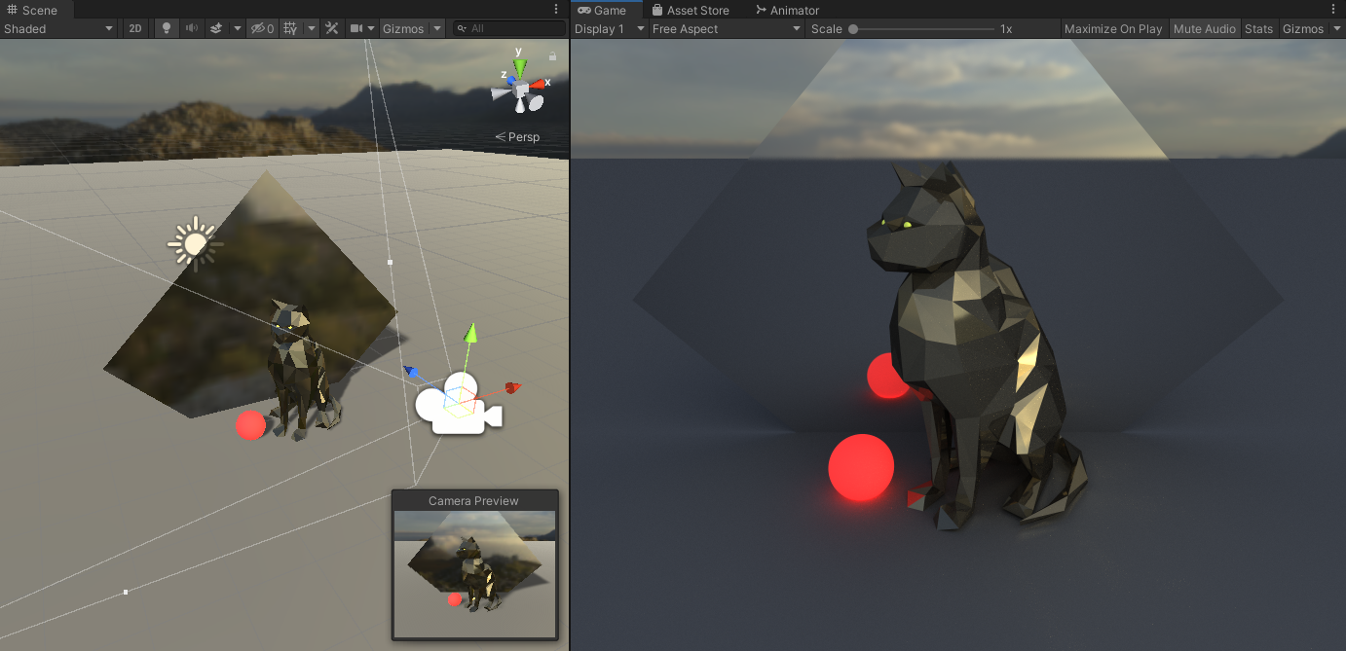
Scene Management

Slide 16

Thank You !
noe@masse.pro

Slide 17
References
Blue-noise Dithered Sampling​
Iliyan Georgiev & Marcos Fajardo​
​
Distributing Monte Carlo Errors as a Blue Noise in Screen Space by Permuting Pixel Seeds Between Frames​
Eric Heitz & Laurent Belcour, Unity Technologies Grenoble​
​
Progressive Multi-Jittered Sample Sequences​
Per Christensen, Andrew Kensler & Charlie Kilpatrick, Pixar Animation Studios​
​
Special Thanks​
Alan Wolfe, NVIDIA, blog.demofox.org​
David Kuri, Three Eyed Games, GPU Path Tracing in Unity series​

